Slide 1
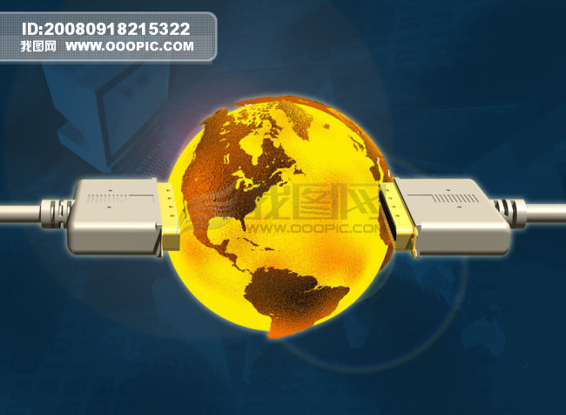
Unit 2 Future of Net Economy
As we have entered the new century, human society is beginning its move from the industrial economy into the knowledge-based economy. In more specific terms, the application of information to the economy is best used in the networking of communication, or the so-called Net economy. This Net refers to the computer network of satellites, optic fibers and telephone lines that connect the whole world. With the click of a mouse, information from the other end of the globe will be transported to your computer screen at the extremely fast speed of seven-and-a-half times around the earth per second. Generally, there are two aspects of the Net. One is the networking between businesses and their customers. The other is the networking between individual businesses, or the regional and even global networking between industrial production and scientific
research. Internet shopping belongs to the
first aspect.

Slide 2

From a long-term perspective, Internet shopping is but a low-level aspect of the Net, and it is not likely to become the most important trend. After all, most commodities are unsuitable for Internet shopping. Besides, if everyone shops on the Net, what will happen to the hundreds and thousands of shopping malls? Therefore, the second aspect of the Net will be more important. Its significance goes beyond that of connecting businesses. There have been reports of immediate consultation of doctors from all over the world on
the Internet. These are
early examples of
high-level networking.

Slide 3

It is estimated that the new interaction between computers and Net technology will have significant influence on the industry of the future. The huge power of electronic commerce (e-commerce) will change the face of trade dramatically. Sporting goods company Puma was on the verge of bankruptcy back in 1992. From 1993, Puma began to diffuse its production, logistics and marketing divisions to 80 Net enterprises worldwide, and the results were spectacular. Puma was transformed from a common company into a magnificent one. The reason for this transformation is that intra and inter-business electronic links greatly increase the efficiency of production, planning, the collecting of information and data exchange. As the business is rapidly being rationalized, production figures go up
while costs come down.

Slide 4
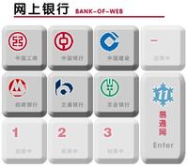
The development of e-commerce may well bring the world into a brand new era of “electronic currency”. With the emergence of an electronic currency, everyone of us would be affected. At the moment, developed areas in Europe, the United States and Asia have already started studying the possibility of an electronic currency. Electronic currency is not only about currency. It refers to an entire finance system on the Net. It includes a virtual numeric currency, an electronic system of withdrawals, transfers and loans, and Smartcards (electronic purses) of all shapes and sizes. The appearance of an electronic currency system implies the emergence of “virtual banks” and “virtual enterprises”. Actually, the original beginnings of a virtual bank appeared in the US in 1995 as the Security First Network Bank, the world’s first Internet bank. Although it is a small and insignificant bank, it represents the trend of the future. In time to come, we may even have to abandon the familiar paper currency.

Slide 5
As the Net pushes the economy ahead rapidly, the economy is also bringing the Net market forward, resulting in the Internet itself becoming the world’s largest emerging market. Of course, this is just the beginning. Although there are many companies which made huge profits investing in the Internet market, they tend to be small companies, like Yahoo (at that time). To date, most companies are making losses. The Net and e-commerce will foster a large number of free-lancers, and this will affect social structure in a big way. The competition for technological superiority in the era of the knowledge-based economy will also be more intense. This will definitely promote greater (even global) and more efficient cooperation to maintain competitiveness. The highly efficient research and development work will be conducted worldwide. The Net is best suited for small and medium enterprises to band together and break the monopolies of the “giants”.

Slide 6
V & S
A. 1. foster
2. intense
3. To date
4. superiority
5. promote
6. on the verge of
7. trend
8. perspective
9. emergence
10. medium

Slide 7
Part C Supplementary Reading
1. B 2. A 3. A 4. C 5. B
6. B 7. D 8. A 9. B 10. A

